Slide 1
ADAMS training Day 3
陳劍航

Slide 2
Outline
Topics
Flow Chart : Basic Model
Between parts: Construction
Joint construction(friction)
Joint construction(spring / damper)
Motion
Contact
Flow Chart : Variable Construction and Export model

Slide 3
Topics
Topic 1:
We will briefly introduce the use of ADAMS interface, two examples will be show.
Topic 2:
How to use ADAMS link Matlab Simulink.
Topic 3:
How to link the CAD files to ADAMS.

Slide 4
Flow Chart : Basic Model

Slide 5
Model Construction
機構組合檔
Splitting parts save as X_t files in the same assembly files
Create a new model(set directory)
File Import :Parasoid & Part Name
@Joints: Motion construction
Run Simulation for checking error
Axis tuning with Position Rotate
Object Right click: Material selection
Between parts: Joint construction(friction)
Run Simulation for checking error
Floor established
Set a fixed joint with ground
Contact construction
Flow Chart : Basic Model

Slide 6
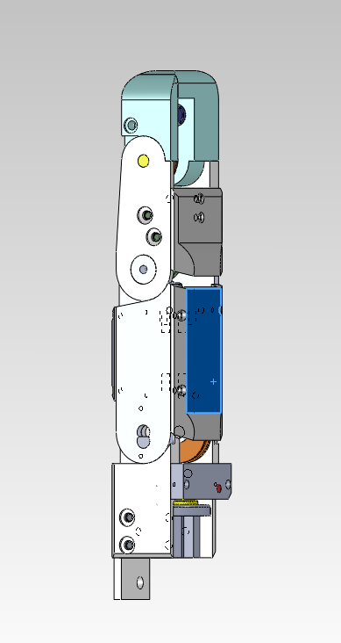
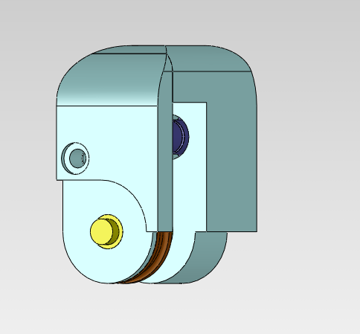
從Solidworks匯入

Slide 7
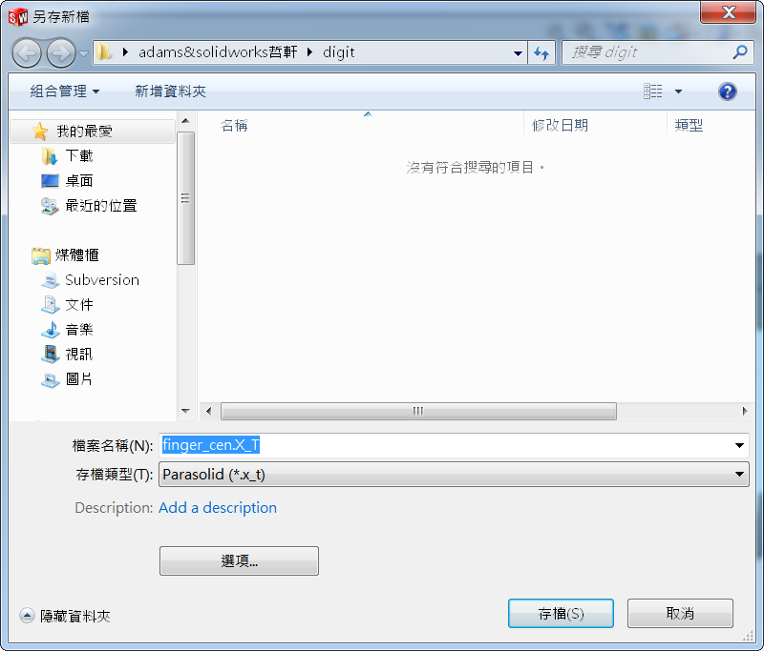

Slide 8
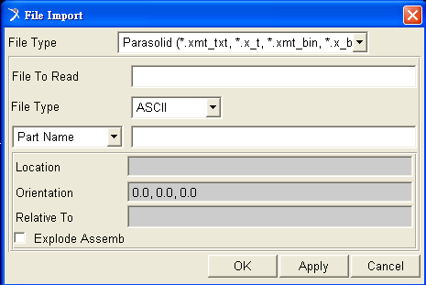
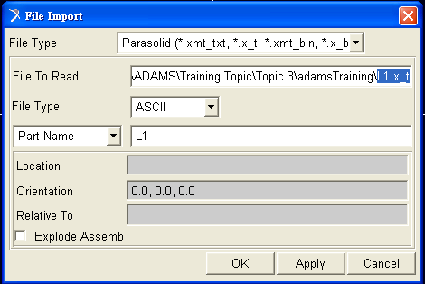
Model Import
File->Import…

Slide 9
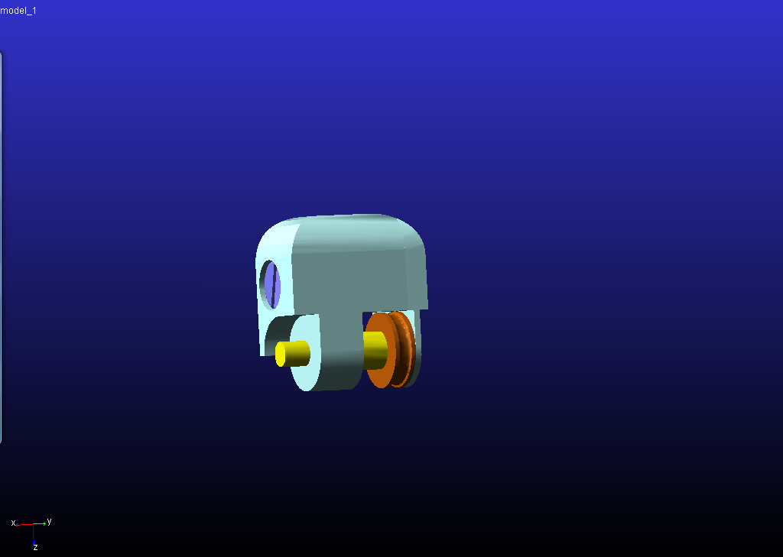

Slide 10
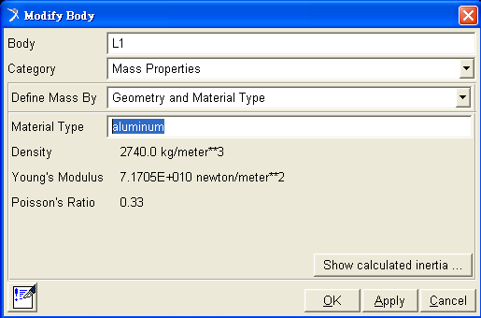
Object Right click: Material selection
Ctrl+E (Part->Modify)
Material Type : Al

Slide 11
Simulation : No Error !

Slide 12
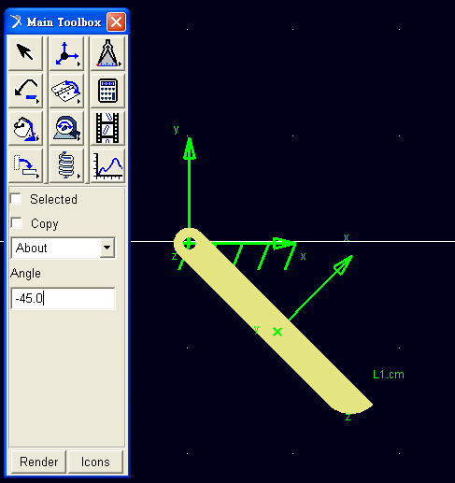
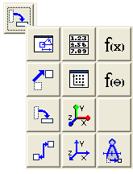
Rotation
ps : 善用Marker !

Slide 13
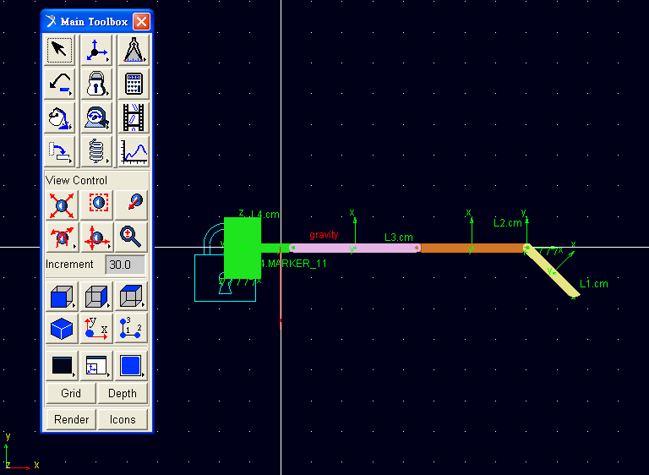
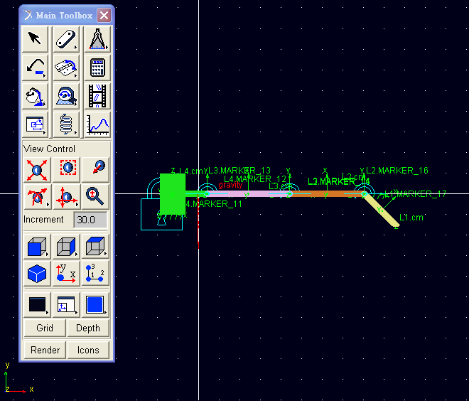
Model Import / Add joint construction

Slide 14
Between parts: Construction

Slide 15
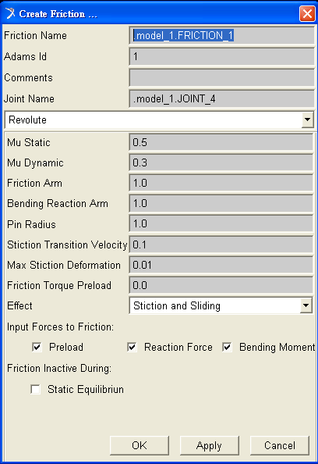
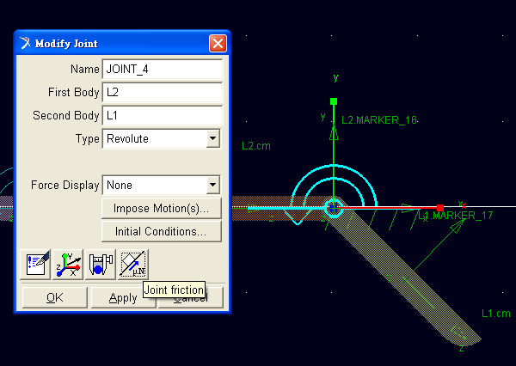
Between parts: Joint construction(friction)

Slide 16
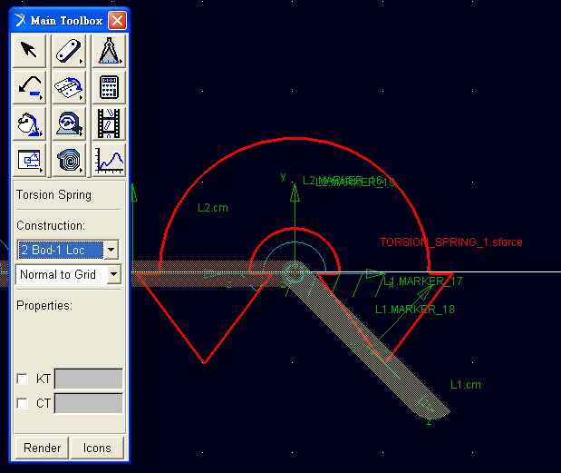
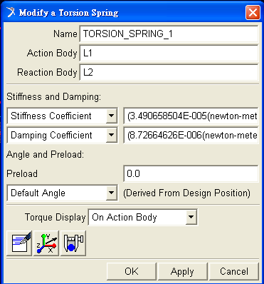
Between parts: Joint construction(spring / damper)

Slide 17
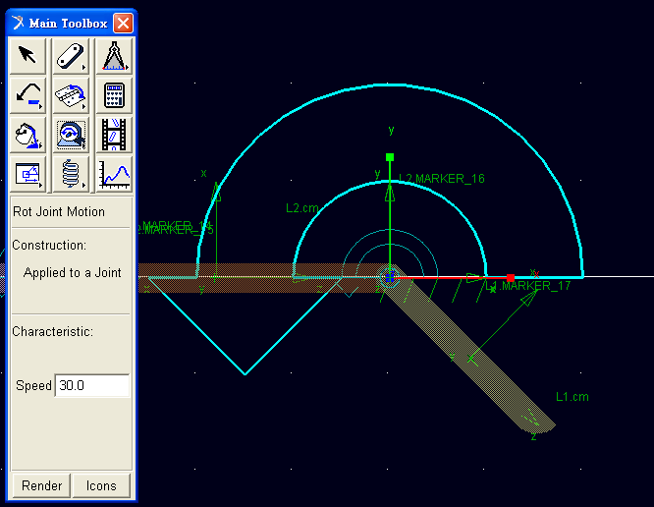
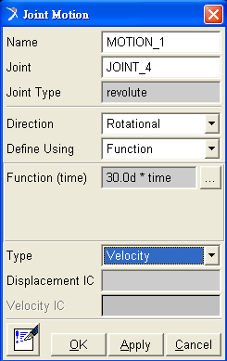
Motion Construction

Slide 18
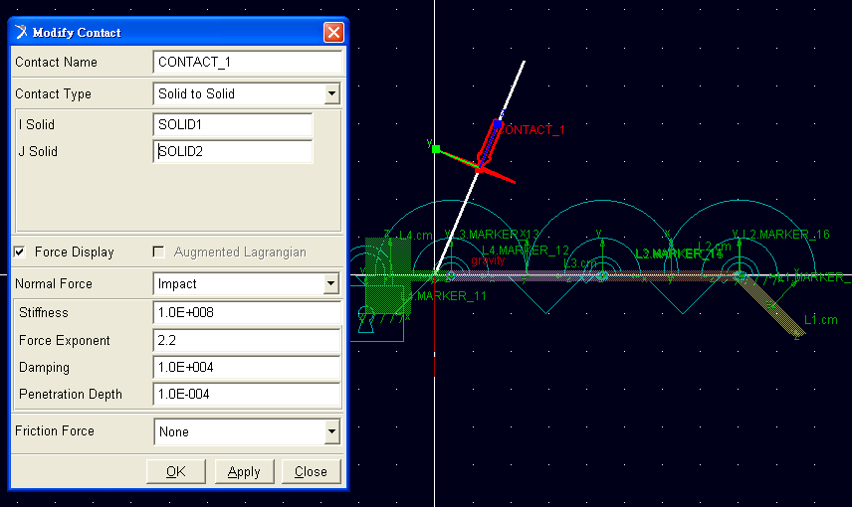
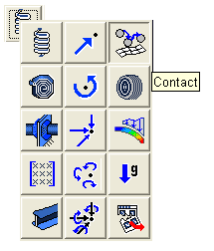
Contact Construction
!!Solid and box only

Slide 19
Model Construction
Flow Chart : Variable Construction and Export model
.bin file
Variable construction
Variable assignment on motion
Tool Plug-in Manager(1st)
Controls Plant Export
Simulink
: run m file
adams_sys 生成block
File Naming and
Create input/output

Slide 20
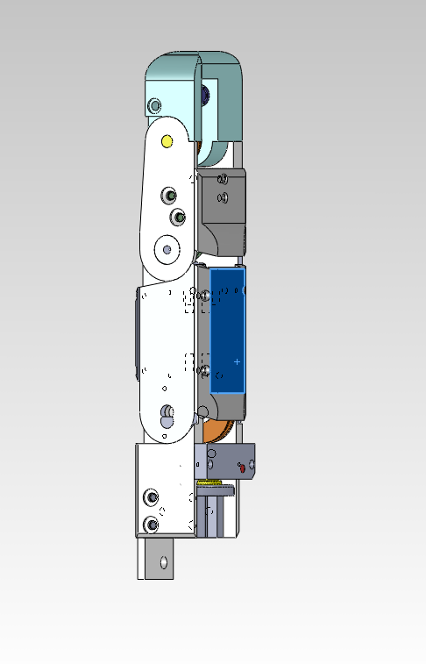
HW
Joint 1 , commandtheta1 ,measuretheta1
Joint 2 , commandtheta2 ,measuretheta2
Joint 3 , commandtheta3 ,measuretheta3
fixed

Slide 21
做 位置迴圈的 PID 控制
讓joint 1 . 2 .3 分別追到指定角度
joint 1 20度
joint 2 20度
joint 3 40度

Slide 22
Solve s-function error problem
http://www.baisi.net/viewthread.php?tid=3043209

